Slide 1
Welcome to
Our Sunday School
We’ll start at 9:07
visit OurSundaySchool.com for more about our class

Slide 2
Today’s class (pages 118-124)
Philippians 2:5-6

Slide 3
Philippians 2:5-6 (CSB)
Adopt the same attitude as that of Christ Jesus,
who, existing in the form of God, did not consider equality with God as something to be exploited.

Slide 4
Today’s class (pages 118-124)
Philippians 2:5-6

Slide 5
Bloom’s Taxonomy of Learning
Cognitive domain (thoughts) | Affective domain (attitudes) | Psychomotor domain (actions)
Create | Characterize | Origination
Evaluate | Organize | Adaptation
Analyze | Value | Complex overt response
Apply | Respond | Mechanism
Understand | Receive | Guided response
Remember |  | Set
 |  | Perceive

Slide 6
Today’s class (pages 118-124)
Philippians 2:5-6

Slide 7
BDAG on morphe (mor-FAY) form, outward appearance, shape

Slide 8
Today’s class (pages 118-124)
Philippians 2:5-6

Slide 9
Isosceles triangle

Slide 10
Today’s class (pages 118-124)
Philippians 2:5-6

Slide 11
BDAG on harpagmos (harrr-pog-MOS) (1) a violent seizure of property, robbery (2) something to which one can claim or assert title by gripping or grasping, something claimed

Slide 12
BDAG on harpagmos (harrr-pog-MOS) (1) a violent seizure of property, robbery (2) something to which one can claim or assert title by gripping or grasping, something claimed

Slide 13
Prayer Time
Write down your prayer requests (on the Weekly Update or in the comments)
Lean in, engage, and pray for someone not with you
Go worship

Slide 14
Today’s class (page 16)
Preparing for Philippians 1:1-30
Pray with others
Hear with others
Think with others
Study with others In class, as a table
Share with others
Invite others After class
In class, as a class

Slide 15
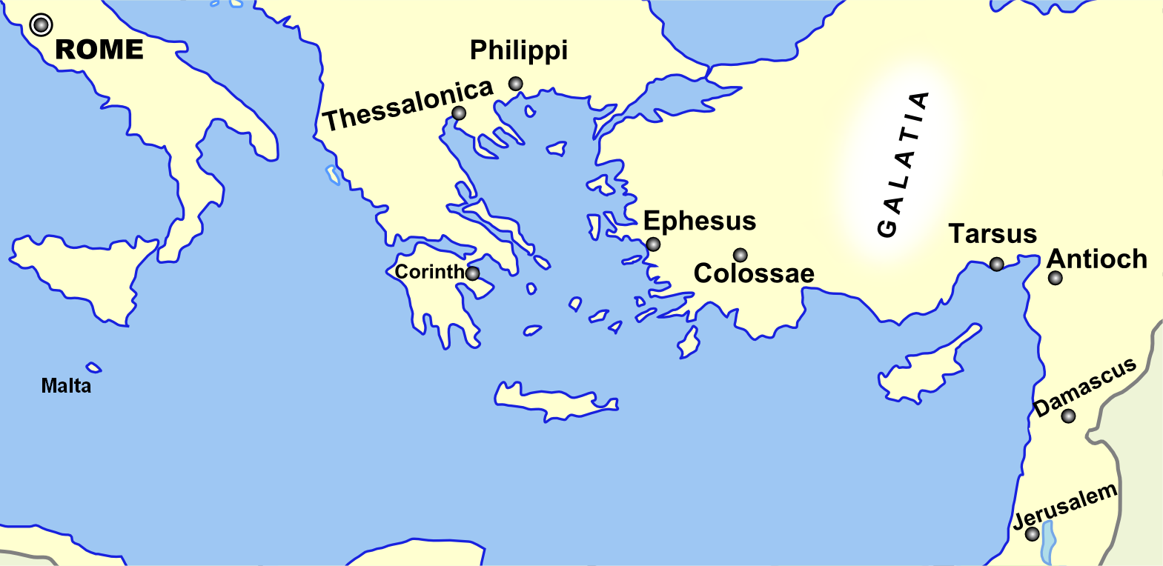
Monozigote. (2012). Broad Overview of Geography Relevant to Paul of Tarsus [Map]. Wikipedia.

Slide 16
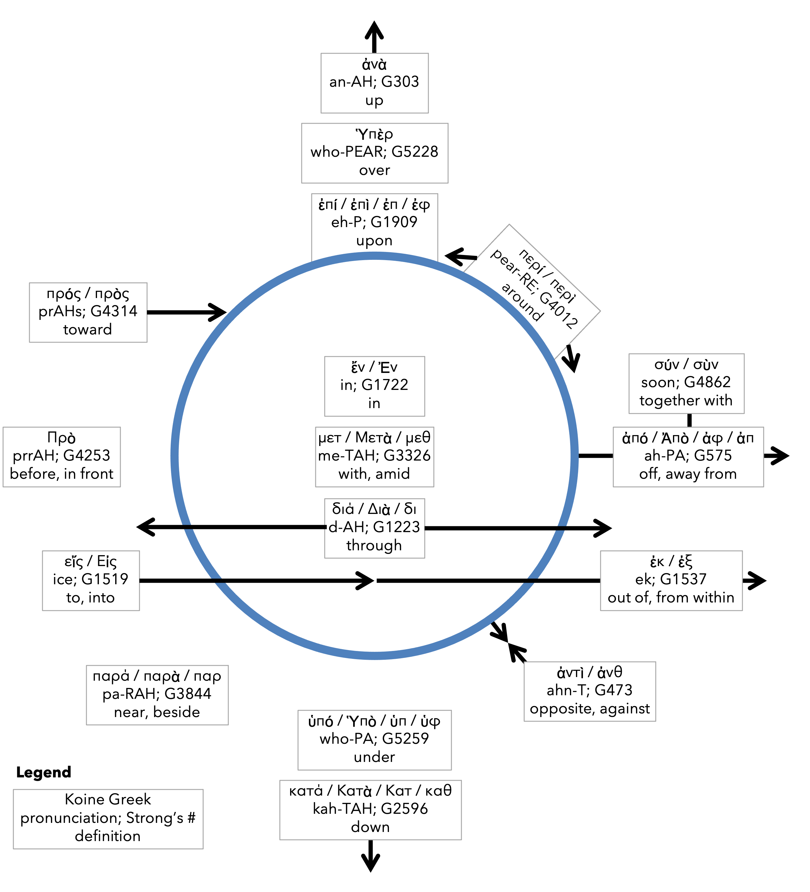
Preposition circle (page 11)

Slide 17
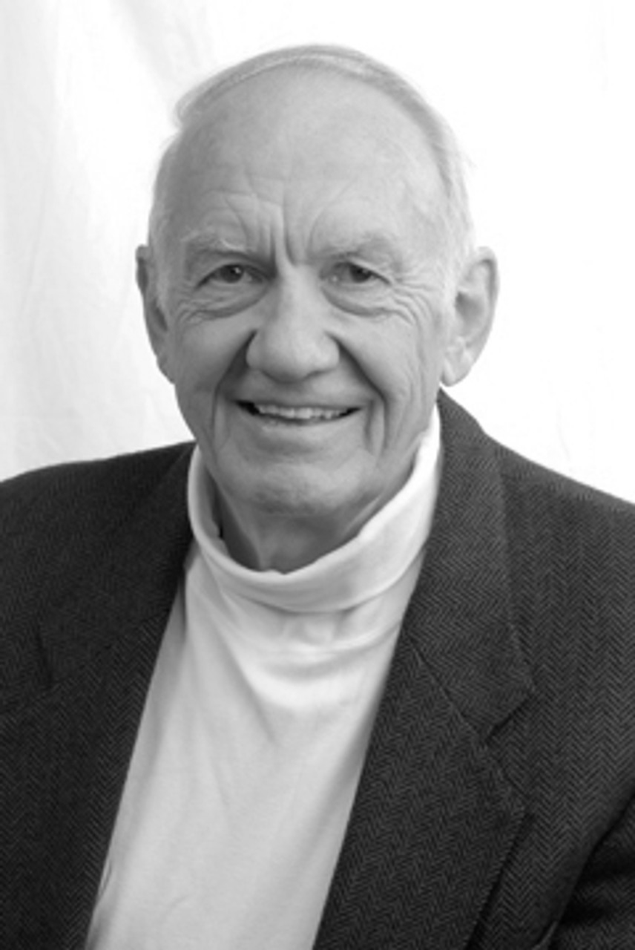
Dr. Gordon Fee Quote

Slide 18
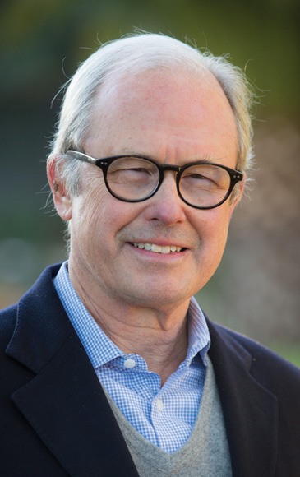
Dr. G. Walter Hansen Quote

Slide 19
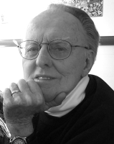
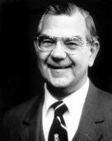
Dr. G. F. Hawthorne & Dr. Ralph P. Martin Quote

Slide 20
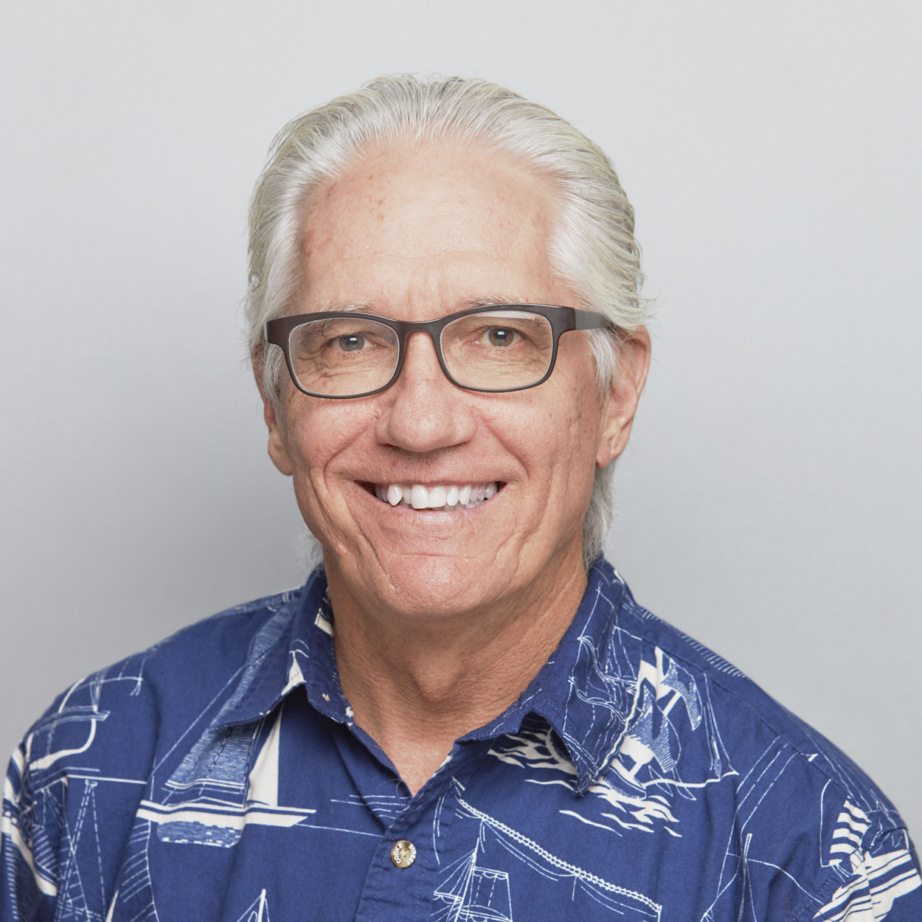
Dr. Joe Hellerman Quote

Slide 21
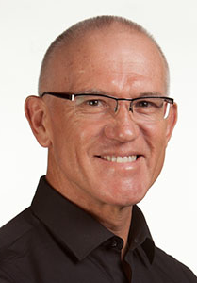
Dr. Mark Keown Quote

Slide 22
Dr. Ralph P. Martin Quote

Slide 23
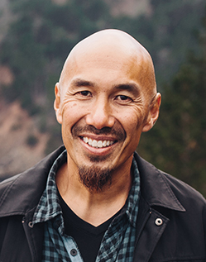
Dr. Tony Merida & Frances Chan Quote

Slide 24
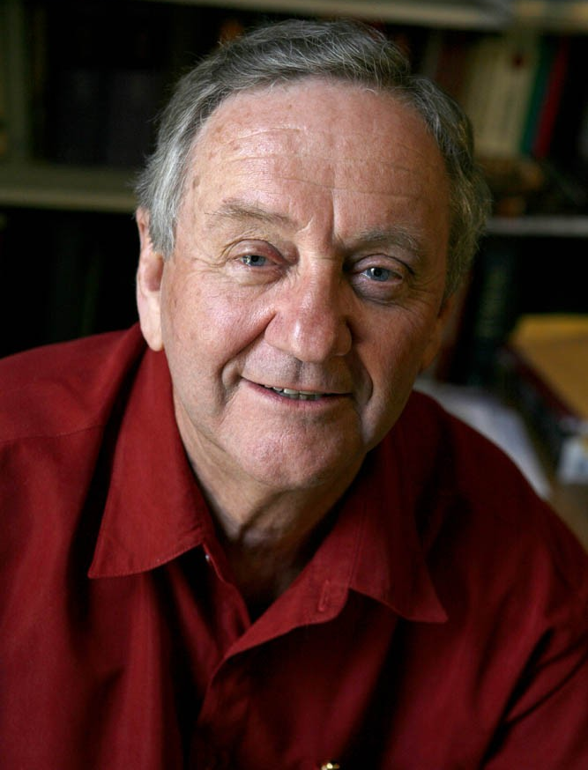
Dr. Peter T. O’Brien Quote

Slide 25
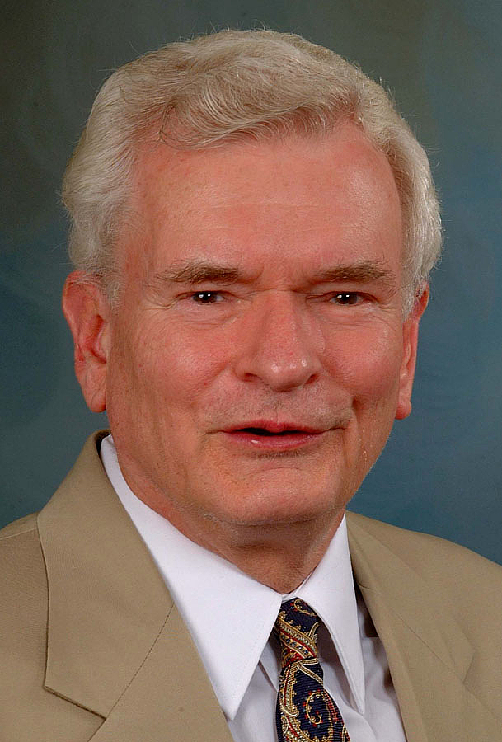
Dr. John Reumann Quote

Slide 26
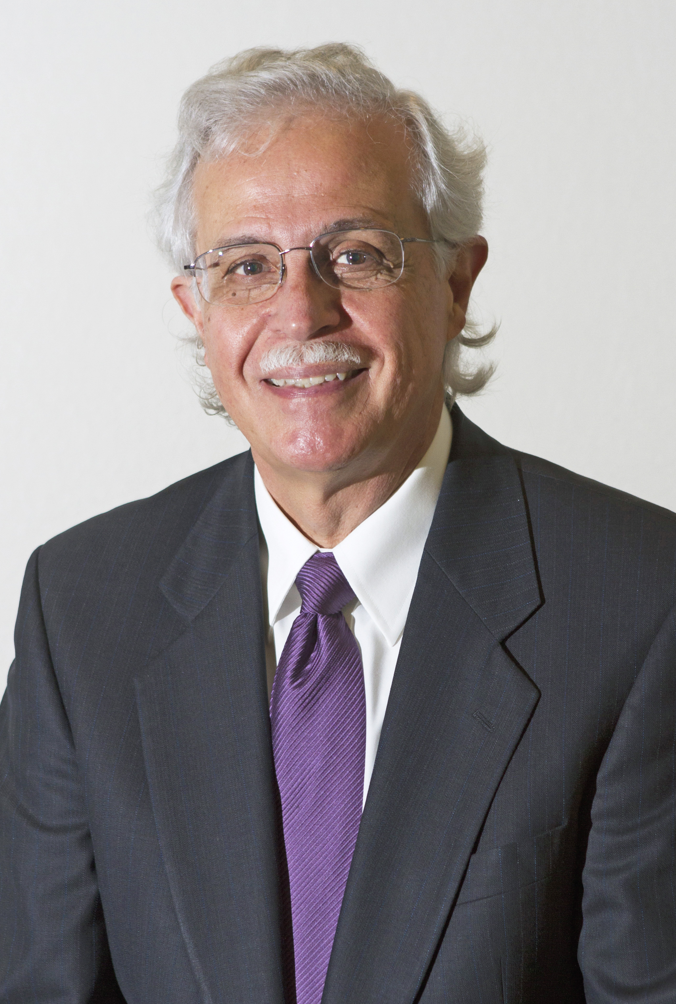
Dr. Moises Silva Quote

Slide 27
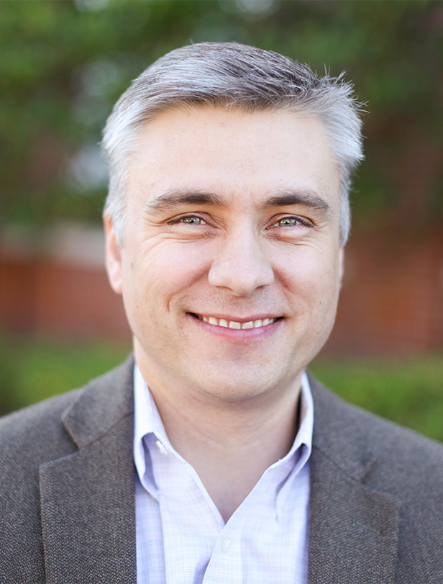
Dr. David T. A. Strain Quote

Slide 28
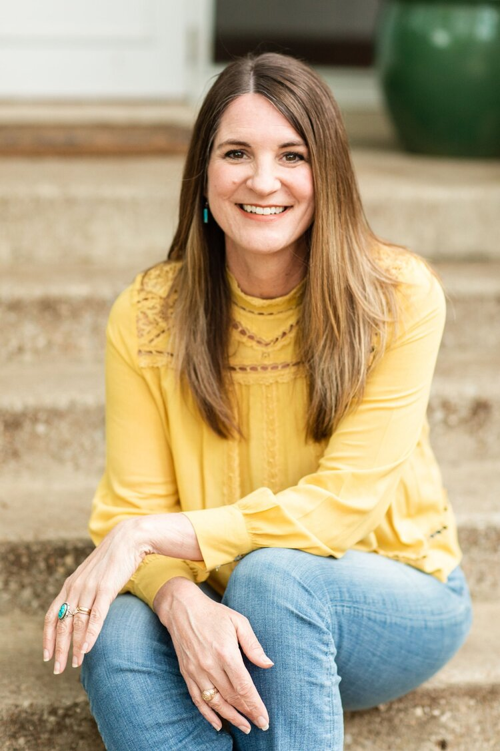
Jen Wilkin Quote

